Slide 1
Complexity analysis
J.Govindarajan, Asst.Prof. (Sr.Gr) , CSE

Slide 2
Introduction
Goal and Evaluation Pattern
Data Structure – Real Time Analogy
Course Outline

Slide 3

Application – Example
A video game which keeps track of the top ten scores for that game.

Slide 4
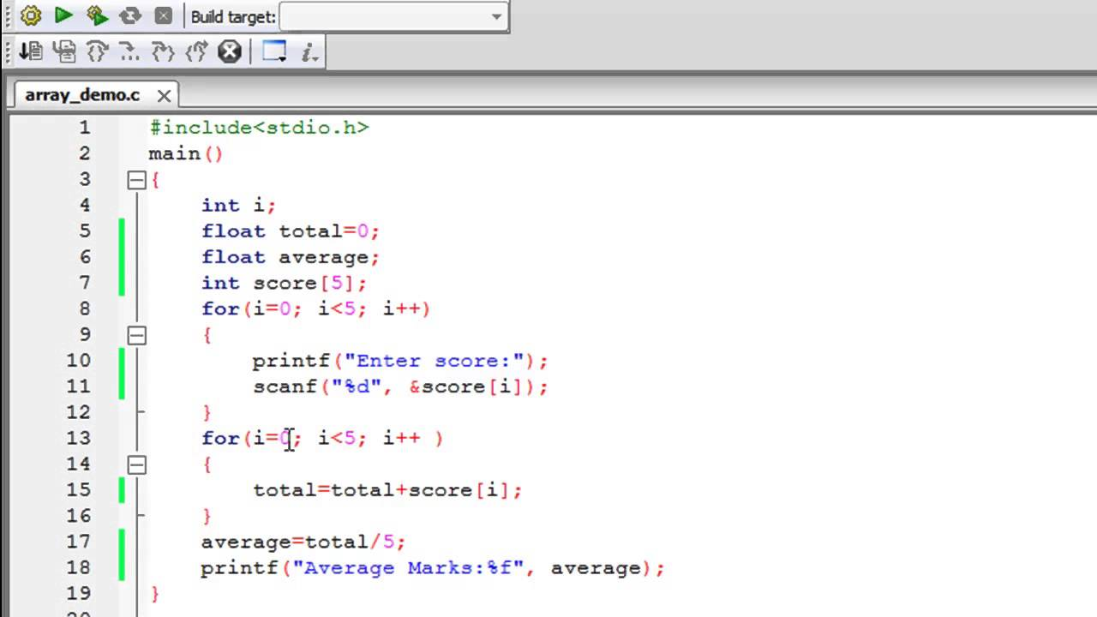
A Simple Application - Array

Slide 5
Analysis of algorithms
Parameters:
Time (running time)
Space (memory requirement)
Methods:
Experimental Analysis (Implement and Measure)
Asymptotic Analysis

Slide 6
Experimental analysis : Issues
Reproducing experimental setup (hardware and software)
Actual time maybe affected by other programs running on the same machine

Slide 7
Asymptotic Analysis
Focus on Growth rate of the running time as a function of the input size n,

Slide 8
Primitive operations
Assign a value to a variable (independent of the size of the value; but the variable must be a scalar).
Method invocation, i.e., calling a function or subroutine.
Performing a (simple) arithmetic operation (divide is fine, logarithm is not).
Indexing into an array (for now just one dimensional; scalar access is free).
Following an object reference.
Returning from a method.

Slide 9
For loop : Splitting into Primitive operations
for i ← 0 to n-1 do
- Initialization i ← 0 => 1 time
- increment => n times
- assignment => n times
- comparison with subtraction for (n-1)
=> 2(n+1) times

Slide 10
Counting Primitive Operations
Algorithm innerProduct
Input: Non-negative integer n and two integer arrays A and B of size n.
Output: The inner product of the two arrays
prod ← 0
for i ← 0 to n-1 do
prod ← prod + A[i]*B[i]
return prod
1
Total no. of primitive operations
= 1+1+2n+2(n+1)+5n+1=9n+5
1+2n+2(n+1)
5n
1

Slide 11
Counting Primitive Operations
Algorithm innerProductBetter
Input: Non-negative integer n and two integer arrays A and B of size n.
Output: The inner product of the two arrays
prod ← A[0]*B [0]
for i ← 1 to n-1 do
prod ← prod + A[i]*B[i]
return prod
4
1+2(n-1)+2n
5(n-1)
1
Total no. of primitive operations
= 4+1+2(n-1)+2n+5(n-1)+1=9n-1

Slide 12
Counting Primitive Operations
Algorithm CountPositives
Input: Non-negative integer n and an integer array A of size n.
Output: The number of positive elements in A
pos ← 0
for i ← 0 to n-1 do
if A[i] > 0 then
pos ← pos + 1
return pos
1
1+2n+2(n+1)
2n
In Best case zero time,
In Worst case 2n times
1
Total no. of primitive operations
= 1+1+2n+2(n+1)+2n+1=6n+5(best case)
= 1+1+2n+2(n+1)+2n+2n+1=8n+5(worst case)

Slide 13
Counting Primitive Operations
Algorithm FindMax(S, n)
Input : An array S storing n numbers, n>=1
Output: Max Element in S
curMax <-- S[0]
i ← 0
while i< n-1 do
if curMax <A[i] then
curMax <-- A[i]
i ← i+1;
return curmax

Slide 14
Counting Primitive Operations
Algorithm FindMax(S, n)
Input : An array S storing n numbers, n>=1
Output: Max Element in S
curMax <-- S[0]
i ← 0
while i< n-1 do
if curMax <A[i] then
curMax <-- A[i]
i ← i+1;
return curmax
Total no. of primitive operations
= 2+1+2n+2(n-1)+2(n-1)+1=6n (best case)
= 2+1+2n+2(n-1)+2(n-1)+2(n-1)+1
= 8n-2 (worst case)
2
1
2n
2 (n-1)
2 (n-1) worst case ; 0 in best case
2 (n-1)
1

Slide 15
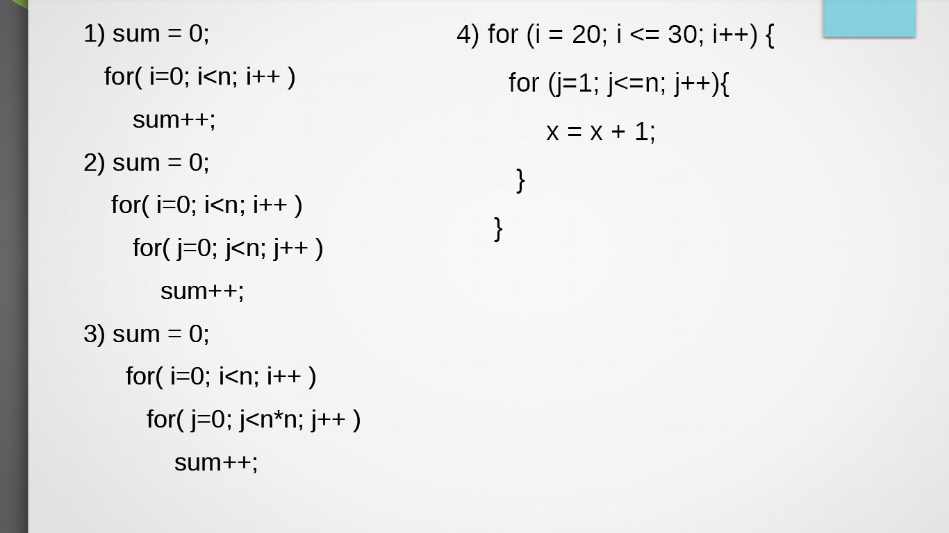
Practice Problems

Slide 16
Growth Rate : Common Functions
Constant function f(n)=c
Logarithm Function f(n) = logn
Linear Function f(n) = n
N-Log-N Function f(n) = nlogn
Quadratic Function f(n) = n²
Cubic Function and Other Polynomials
Exponential Function f(n) = b^{n}
Factorial Function f(n) = n!

Slide 17
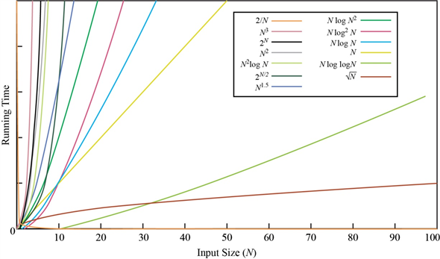

Slide 18
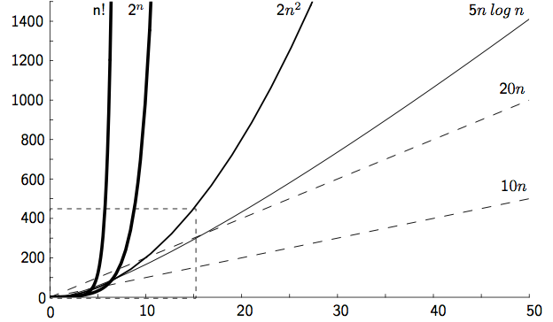

Slide 19
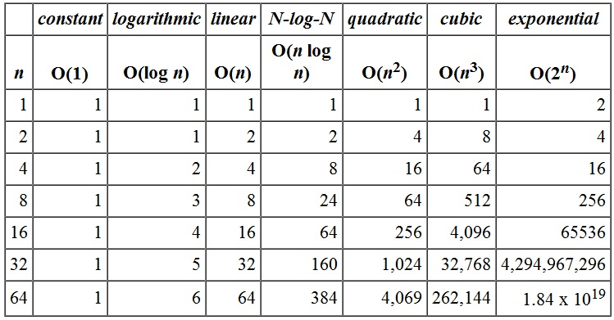
Comparing Growth Rate

Slide 20
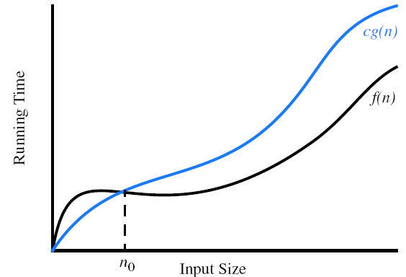
“Big-Oh” Notation
f (n) ≤ c ·g(n), for n ≥ n0
f (n) is O(n)
f (n) is order of g(n)

Slide 21
Example 1:
8n+5 is O(n)
Justification
8n+5 <= 8n+n
8n+5 <= 9n = > here 8n+5 is f(n) and 9n is cg(n)
for C=9 and n₀=5 (i.e, n>=5), 8n+5 <= 9n is true
hence, 8n+5 is O(n)

Slide 22
Example 2
5n⁴ +3n³+2n² +4n+1 is O(n4)
Justification:
5n⁴ +3n³+2n² +4n+1 <= (5+3+2+4+1)n⁴
<= 15 n⁴
for C=15 and n_{o}=1 the
5n⁴ +3n³+2n² +4n+1 is O(n⁴)

Slide 23
Example 3
a⁰+a¹n+a²n²+···+a^{d}n^{d} is O(n^{d})
Justificaiton
a⁰+a¹n+a²n²+···+a^{d}n^{d} ≤(|a⁰|+|a¹|+|a²|+···+|a^{d}|)n^{d}.
for c= |a⁰|+|a¹|+|a²|+···+|a^{d}|) and n_{o}=1
O(n^{d})

Slide 24
Exercise: Prove
5n² +3nlog n+2n+5 is O(n²)
20n³ +10nlog n+5 is O(n³)
3log n+2 is O(logn)
2^{n+2} is O(2^{n})
2n+100log n is O(n)

Slide 25
BigOh : Functions in simplest terms
f (n) = 4n³ +3n² is
O(n⁵)
O(n⁴)
O(n³)
accurate

Slide 26
Big-Omega
f (n) is Ω(g(n))
f (n) ≥ cg(n), for n ≥ n0.
Example:
3nlog n−2n is Ω(nlog n)

Slide 27
Big-Theta
f (n) is θ(g(n))
c′g(n) ≤ f (n) ≤ c′′g(n), for n ≥ n0.
Example:
3nlog n+4n+5logn is θ(nlog n)

Slide 28
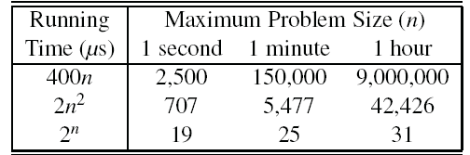
Analysis

Slide 29
Analysis :
Algorithm 1: 10¹⁰⁰n is O(n)
Algorithm 2: 10nlog n is O(nlogn)
Algorithm 1 is faster than Algorithm 2 ?
or
Algorithm 2 is faster than Algorithm 1 ?

Slide 30
BigOh Notation : Summary
The notation gives an upper bound on the growth rate of a function
Use the smallest possible class of functions to represent in big Oh
– “2n is O(n)” instead of “2n is O(n2)”
Use the simplest expression of the class
– “3n+ 5 is O(n)” instead of “3n + 5 is O(3n)”

Slide 31
Exercises
Given an n-element sequence S, Algorithm D calls Algorithm E on each element S[i]. Algorithm E runs in O(i) time when I is called on element S[i]. What is the worst-case running time of Algorithm D?

Slide 32
Exercises
A sequence S contains n−1 unique integers in the range [0,n−1], that is, there is one number from this range that is not in S. Design an O(n)-time algorithm for finding that number. You are only allowed to use O(1) additional space besides the sequence S itself.

Slide 33
BigOh
T(n)= n²
T(n) grows asymptotically no faster than n²

Slide 34
Analysis – Real Time Example

Slide 35

Who will win the race?

Slide 36
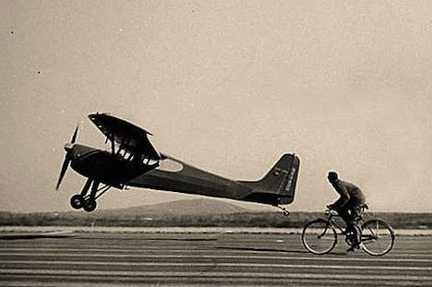
Who will win the race?

Slide 37
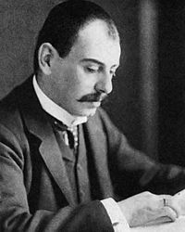
BigOh Notation : History
Invented by Edmund Landau
Bigoh also called as Landau’s Symbol
Applications:
finite series approximation (Mathematics)
-Analysis of algorithms (Computer Science)

Slide 38
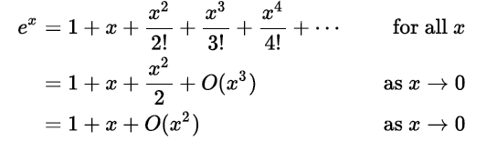
BigOh Notation : History
Specify the error in an approximation to a mathematical function

Slide 39


Big-oh properties
Product
Sum
Multiplication by constant

